Slide 1
ILN in Secondary Welcome!
3 May 2016

Slide 2
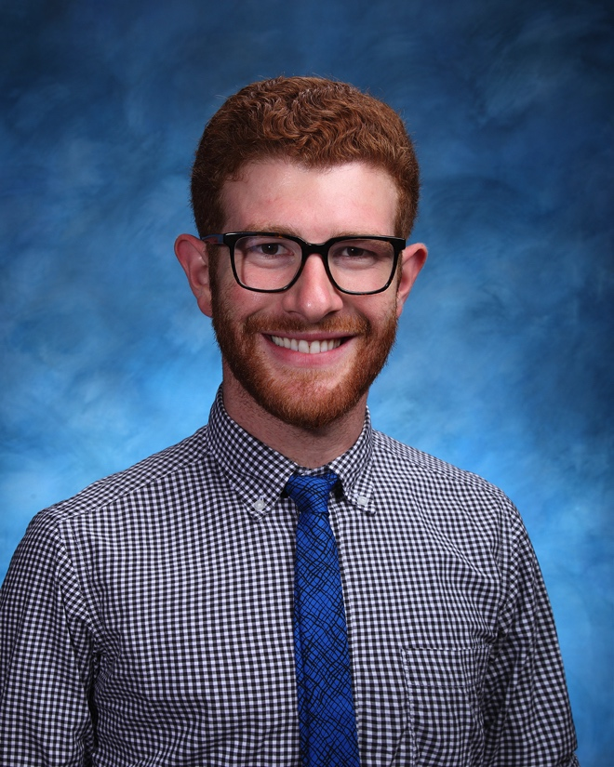
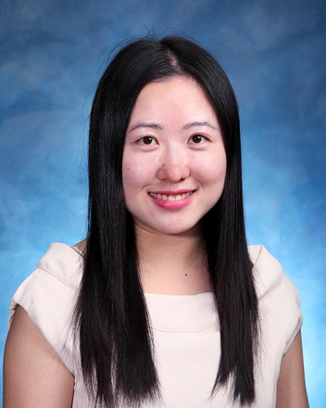
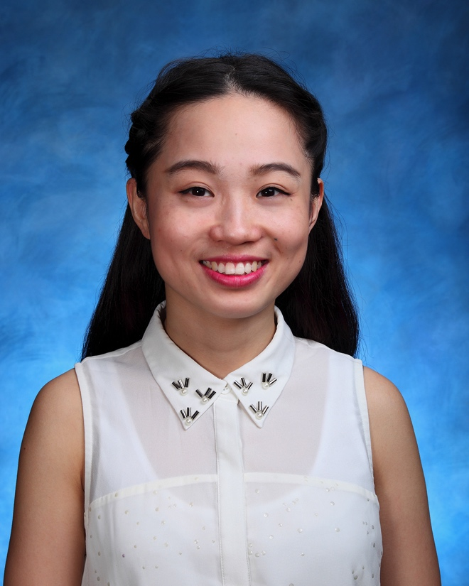
Who We Are
Mr Andrew WAILES
Head of Individualized Learning
Ms Danni LI
Individualized Learning Needs, Chinese and ToK Teacher
Ms Siyi Mary ZHAO
Learning Development Teaching Assistant

Slide 3
What is ILN? Individual Learning Needs

Slide 4
Seems fair? We think not.

Slide 5
But that doesn’t mean we can’t all achieve success!

Slide 7
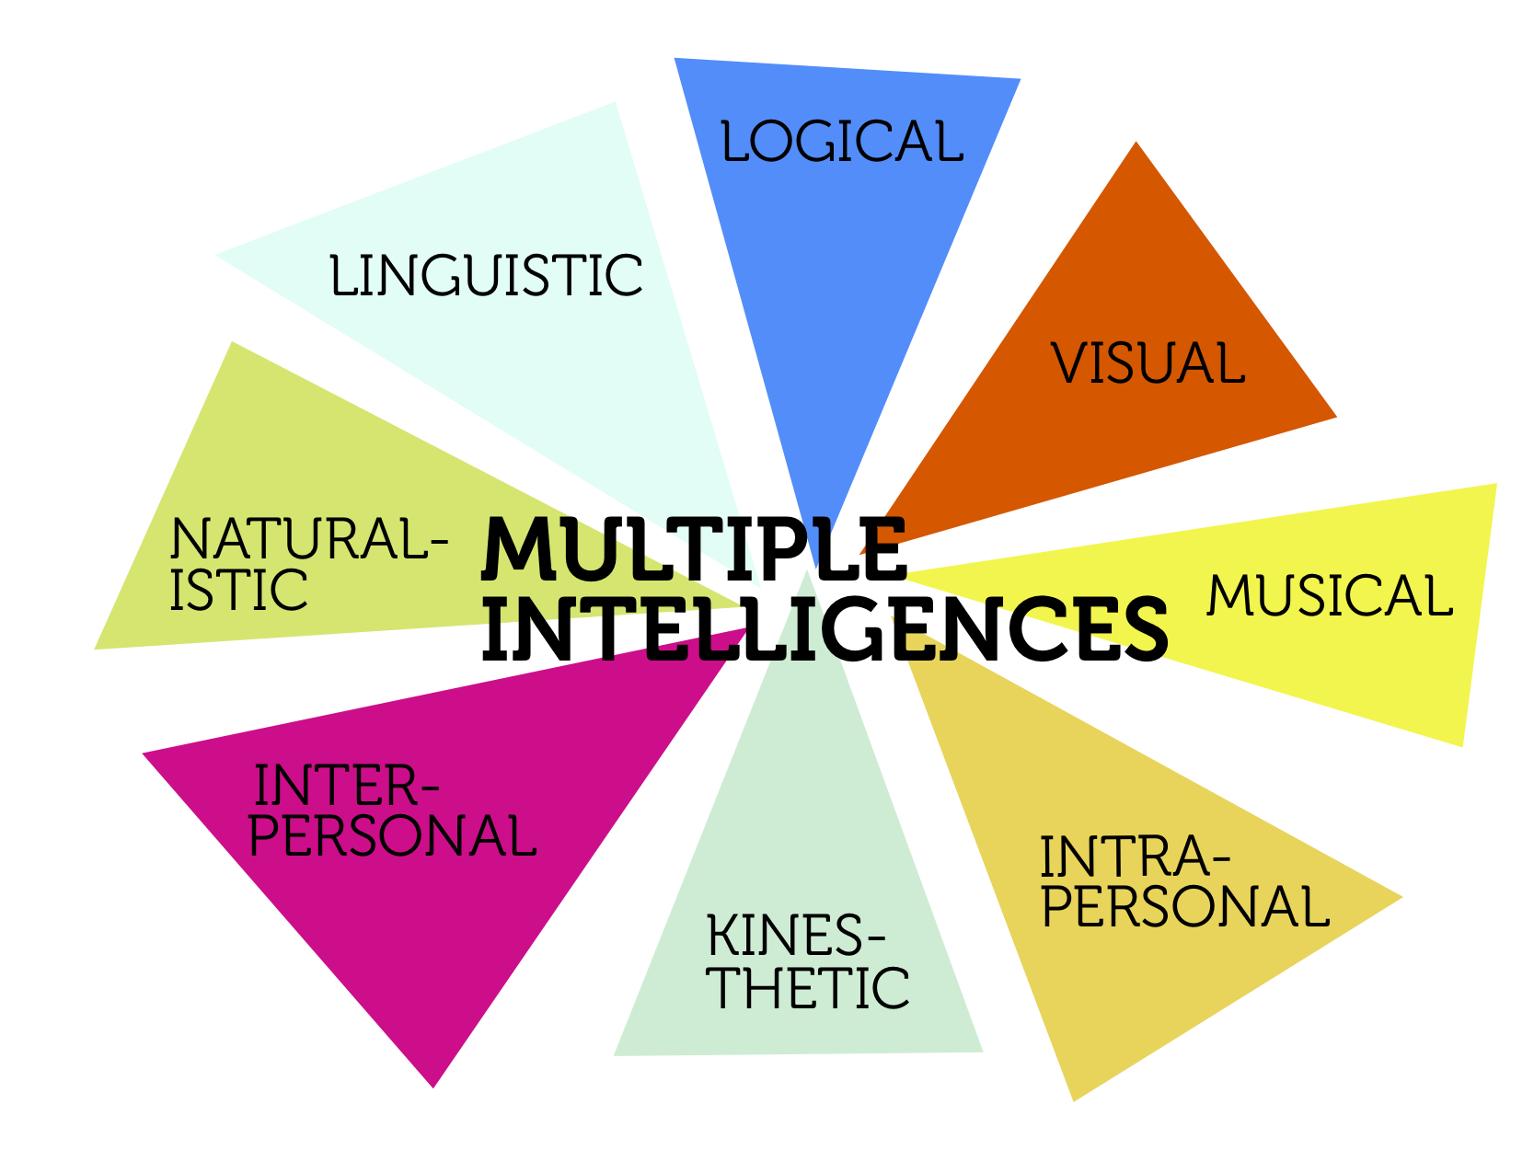
Our goal: Success for all
Everyone has something to offer. It is our job to help bring it to life.

Slide 8
What We Do
We work with students, staff, and parents to ensure that students who are Gifted or who have SEN (Special Educational Needs) are educated holistically and in a seamlessly differentiated environment
We stress that this is a collaborative effort, that all parties involved (ILN staff, curriculum teachers, students, parents) must work together to ensure a cohesive experience that fosters success

Slide 9
8 Classifications of SEN
These need to be identified by a doctor or educational psychologist.

Slide 10
Protocol for Identifying Needs
Our First Step: Identifying Students in Need
Teacher/Parent Referral
In-class observation
Conference with student
Conference with parent
Referral for medical or psychological examination
*For gifted students: Referral to HKAGE
Based on results of exam, write IEP and determine support

Slide 11
IEP Protocol
We work collaboratively with teachers, students, and parents in order to best target our support.
The IEP is a living document, and can be adjusted as needed to best address the students’ needs and any relevant supports
Step 1: Contact Parent
Step 2: Confirm Meeting Date
Step 3: Collect Data
Step 4: Meet with Student
Step 5: IEP Meeting
Step 6: Finalize IEP

Slide 12
IEP Preview

Slide 13
IEP Preview

Slide 14
IEP Preview

Slide 15
Services Available (in school)
We believe in an inclusive model of education, and provide a diverse range of support to meet our students’ needs. The goal of this support is to foster self-advocacy and independence.
In-class support
Small Group Instruction
Learning Buddies
School-wide awareness & differentiation resources

Slide 16
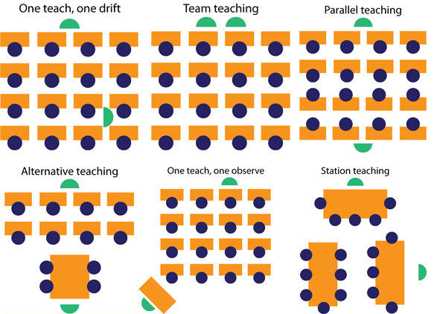
In-Class Support
Mostly for younger MYP students.
Inclusive Teaching Practices
Integrated Co-Teaching supports all students, not just those with individual needs

Slide 17
Small Group Instruction
Social skills
Organization skills
1:1 mentoring & revision sessions

Slide 18
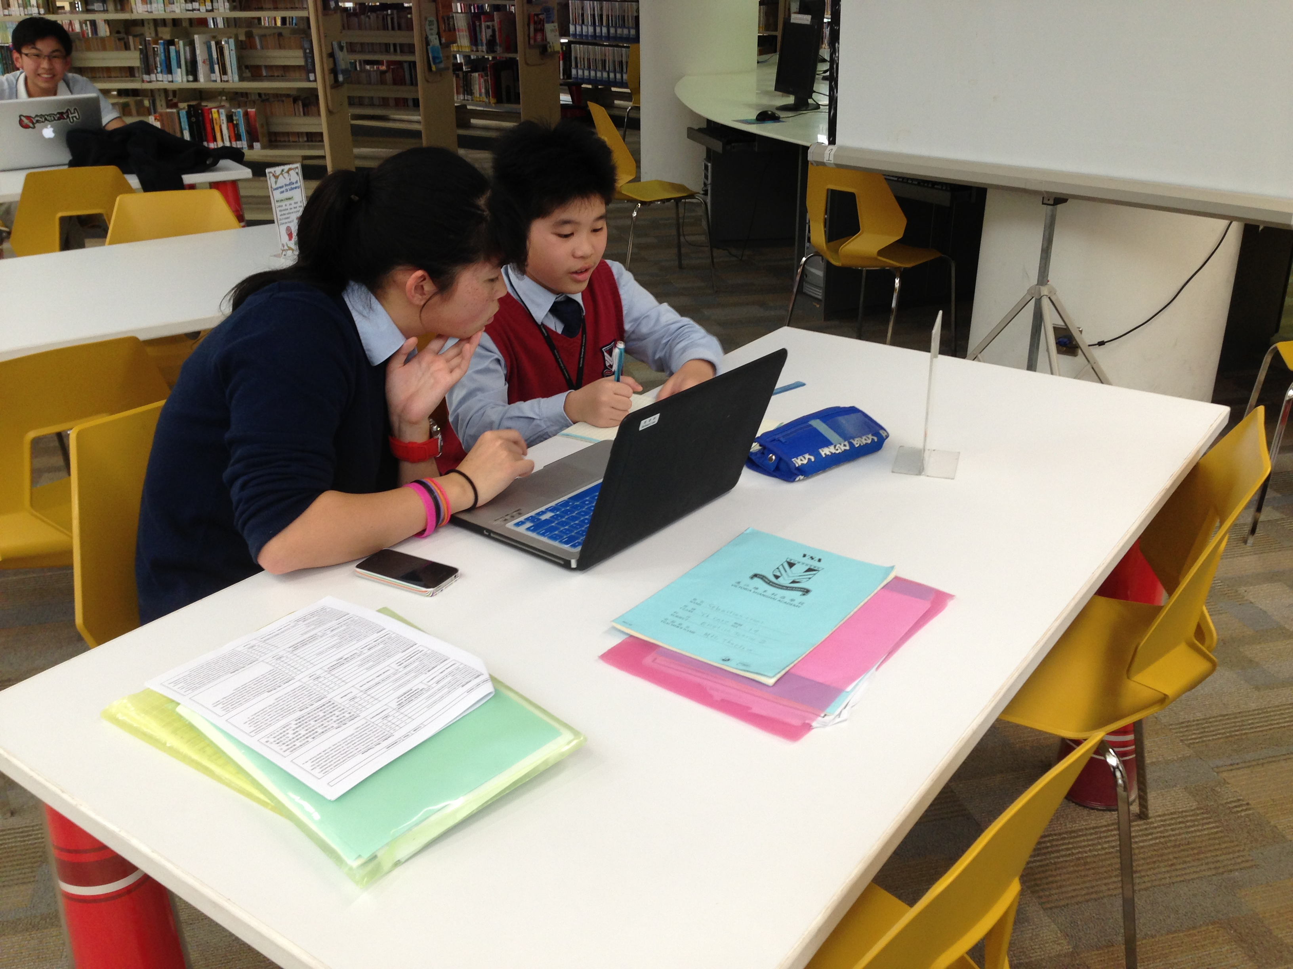
Learning Buddies
Y06-Y08 students (chosen based on need and availability) are paired with Y11 students for individualized homework and skill-building support

Slide 19
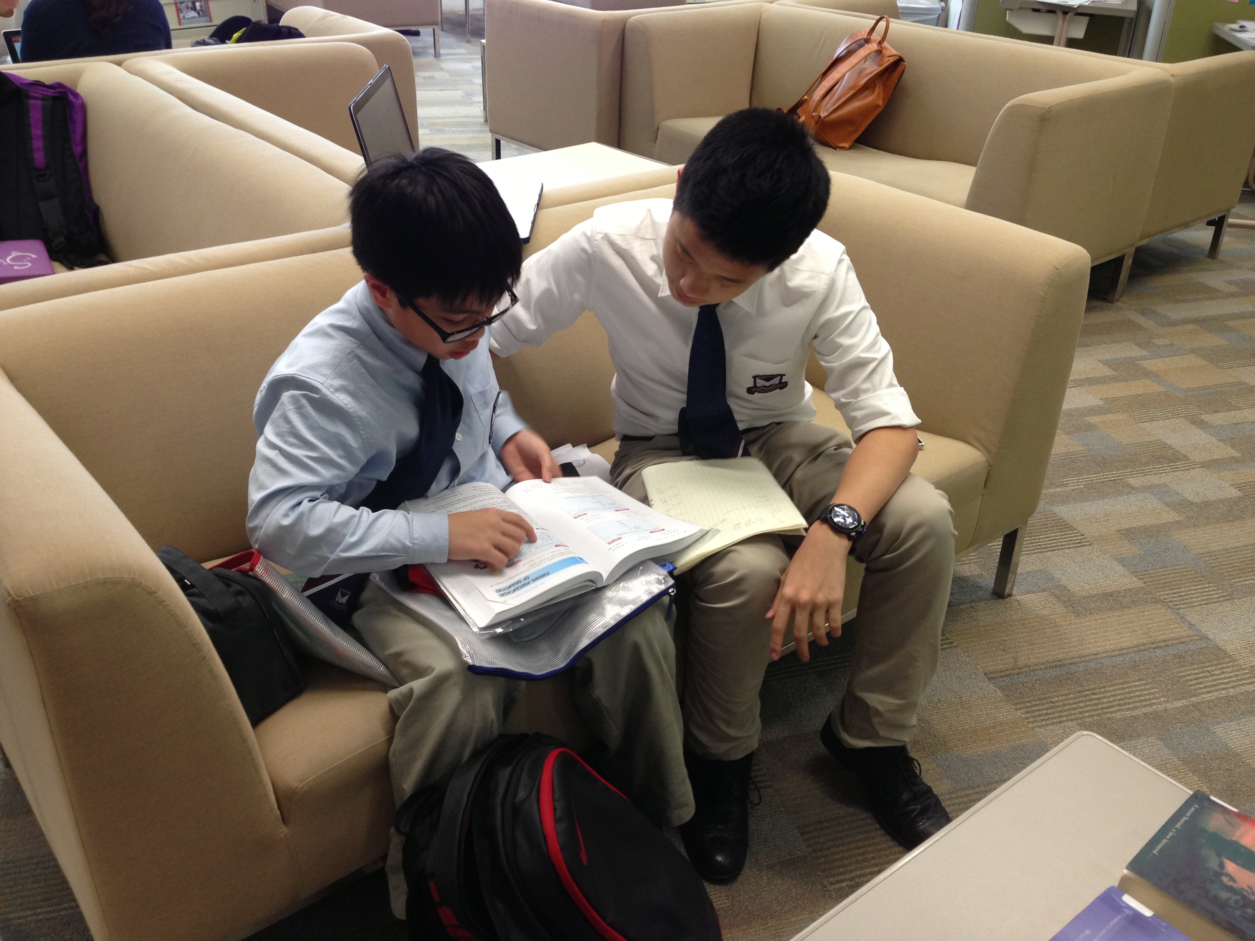
Learning Buddies
A great opportunity for all students involved!

Slide 20
School-Wide Supports
For Students:
CAS week trips – next stop: Australia!
Homeroom visits
Exam revision sessions
For Teachers:
Supporting Staff with differentiating resources
Department Training
For Parents:
Annual Reviews
Student/parent conferencing

Slide 21
We aim to make the IB curriculum accessible to all of our students

Slide 22
Services Available (outside of school)
Hong Kong has a wealth of resources for students and parents alike.
Please visit the ILN website, under “Resources for Parents” to see a list of Outside Services, including music therapy, targeted supports, parent workshops, doctor contacts, etc.
ILNatVSA.weebly.com

Slide 23
A note on Gifted Education
We have a strong relationship with the Hong Kong Academy for Gifted Education, and have several students in each year group who have benefited from the extensions and challenges that HKAGE provides
Each term, teachers nominate students for HKAGE → If students are accepted, they are invited to join the program, which enables them to register for higher-level courses

Slide 24
The Parents’ Role
To achieve holistic education experience, we need seamless cooperation between parent, student, and school.
We have a new IEP protocol this year – parents are invited to come in for a comprehensive overview of the student’s needs and received services
The IEP is a tool and should be used in school and at home
Communication is key!

Slide 25
Parents’ Role – Cont’d
The Center for Parent Information and Resources is a US-based organization that offers some very useful information and advice for supporting students with specific disabilities
http://www.parentcenterhub.org/repository/specific-disabilities/

Slide 26
Transitioning to Secondary
The transition from PYP to MYP offers exciting opportunities to incoming Year 6 students
Organization is key
All year 6 students and parents will be introduced to Wunderlist as a way to track their assignments
Teachers post homework on their websites, which can be easily accessed on the School Portal
HOPS program & Digital Literacy Sessions to further support students and prepare them for life in secondary

Slide 27
New for 2016-17
We have reconfigured the language offerings, effectively removing Lang B in MYP
Students will take both English and Chinese Language & Literature, with support offered for those who need it, based on teacher recommendations
The ILN team is working closely with English & Chinese departments to structure the extra support lessons so as to best target students’ needs

Slide 28
Contact Us
Please feel free to come visit us in the ILN room in the back of the library. We are happy to schedule individual meetings.
Mr. Wailes ~ awailes@vsa.edu.hk
Ms. Li ~ dli@vsa.edu.hk
Ms. Zhao, mzhao@vsa.edu.hk
Tel: +852 3402 1222
Fax: +852 3402 1299

